Slide 1

Prepare for a
comfortable retirement
By participating in your Onondaga County 457(b) Plan
Notes:
Title Slide Good morning/afternoon. My name is ____________ and I’m with ___________________.
First congratulations! You’re here because you see the value in participating in your [401(k)/403(b)/457] retirement plan. Today, we’ll talk about how to make the most of your plan, so you can prepare for a more comfortable retirement.

Slide 2
Contents
Helping you prepare for a comfortable retirement
1
How your plan works
2
Why it’s important to save now
3
Investing your money
4
Enroll and manage your account
5
Working with Equitable
Important note: Equitable believes education is a key step toward addressing your financial goals, and we've designed this presentation to serve simply as an informational and educational resource. Accordingly, this presentation does not offer or constitute investment advice, and makes no direct or indirect recommendation of any particular product or of the appropriateness of any particular investment-related option. Your needs, goals and circumstances are unique, and they require the individualized attention of your financial professional.
Notes:
Here are the topics we’ll cover today.
READ SLIDE

Slide 3



How your plan works
Notes:
Now, let’s take a look at how your [401(k)/403(b)/457(b)] plan works. Specifically, how you make contributions and how you can get employer contributions too.

Slide 4

What is a 457(b), anyway?
Tax-advantaged savings
Flexibility to adjust as your needs change
Supplement to help you cover expenses in retirement
Pension: essential expenses like housing, food and healthcare
Retirement savings plan: other expenses so you can enjoy the kind of retirement you want
Use it to cover expenses in retirement
Helping you turn your salary into a more comfortable retirement
4
Notes:
Variable Slide
First, let’s take a step back and define what a 401(k)/403(b)/457 really is. Technically, it’s a tax code. But for you, it’s a savings plan that has some pretty great tax advantages, gives you the flexibility to adjust your savings rate and investments as your needs change, and can be used to supplement your Social Security benefits, as well as any other savings you have for retirement. Some retirees think of it this way…you can use your Social Security to pay essential expenses, like rent or mortgage, insurance and utilities. Then you can use your 401(k)/403(b)/457 to cover other expenses, to help you live a more comfortable retirement.

Slide 5




Your contributions
Make contributions from your paycheck
Roll money into your account
Pretax contributions
After-tax Roth contributions, if available
Up to 100% of pay or $23,500¹
Plus
An extra $7,500 if you’re 50+^{1,2,3}
From other retirement accounts
[3-year catch-up provision⁴]
1 In 2025, the total amount you may contribute is the lesser of 100% of compensation or $23,500.
If you are age 50 or older, you may be able to make catch-up contribution of up to $7,500.
If you are ages 60-63, there is a “super catch-up“ contribution of $11,250
4 Three-year catch-up provision is the lesser of twice the annual limit ($47,000 in 2025) or the basic annual limit plus the amount of the basic limit not used in prior years (only allowed if not using age 50 or over catch-up contributions).
Notes:
Variable Slide
Your contributions can include pre-tax contributions, after-tax Roth contributions and any money you roll into your account from other retirement accounts.
For 2022, you are allowed to contribute up to $20,500 or 100% of pay, whichever is less. If you are age 50 or older, you can contribute an extra $6,500, for a total of $27,000 for the year. If you contribute to a Roth account as well, both of your contributions still can only add up to $20,500 or $27,000 if you’re 50 or older.

Slide 6




Who would benefit from Roth contributions?
If you…
Expect to be in a higher tax bracket in retirement than you are now
Are a younger employee with a longer retirement horizon (more time to accumulate money tax-free)
Are a highly compensated individual who isn’t eligible for Roth IRA, but wants a pool of tax-free money for retirement
Want to leave tax-free money to your heirs
Notes:
Variable Slide
So how do you decide which to contribute to – traditional or Roth? Here are a few people who might benefit from Roth contributions.
READ SLIDE

Slide 7
How do contributions affect your paycheck?
Pre-tax vs. Roth
Monthly contribution into each account
Pre-tax | Roth
$167 | $167
$50,000 annual earnings
4% contribution into Pre-tax vs. Roth
Reduction in take-home pay
Pre-tax | Roth
$125 | $167
Assumes 25% income tax withholding rate, no other payroll deductions. Actual taxes and take-home pay will depend on your individual tax situation. Pretax contributions and any related earnings will be taxed at the time of withdrawal. Any earnings on after-tax Roth contributions are income tax-free if certain conditions are met.
Notes:
Variable Slide Here’s how each will affect your paycheck.
As you can see, the amount that goes into your account is the same for either a traditional or Roth plan. But, your take home pay is reduced by less when you contribute to a traditional account. That’s because your contribution actually reduces your income, which reduces the amount you’ll pay in income tax.

Slide 8
Tax saver’s credit
Who’s eligible?
2025 Saver’s Credit
Credit rate | Married filing jointly | Head of household | All other filers
50% of your contribution | AGI not more than $47,500 | AGI not more than $35,625 | AGI not more than $23,750
20% of your contribution | $47,501 - $51,000 | $35,626 - $38,250 | $23,751 - $25,500
10% of your contribution | $51,001 - $79,000 | $38,251 - $59,250 | $25,501 - $39,500
Age 18 or older
Not a full-time student
Not claimed as a dependent on another person’s return
Notes:
Variable Slide
You may also be eligible for what’s called the Tax Saver’s Credit. If you’re 18 or older, not a full-time student and not claimed as a dependent on someone else’s taxes, you may receive a tax credit for contributing to your retirement account, depending on your adjusted gross income (or your AGI) – as shown here.
READ SLIDE

Slide 9

Tax saver’s credit example
Meet Jill
Gross income | $41,000
Retirement plan contribution | $2,000
Her adjusted gross income for tax purposes | $39,000
Married and earned $41,000 in 2025
Contributed $2,000 to her 457 (b) plan
Her husband is unemployed
Jill may claim a 50% credit of $1,000 for her $2,000 457(b) contribution on her 2025 tax return.
This hypothetical example assumes no other household income. For illustrative purposes only.
Notes:
Here’s an example of the Tax Saver’s Credit.
READ SLIDE

Slide 10
Save on taxes
Advantage of pre-tax saving
Hypothetical example
 | Saving pretax
Gross annual income | $50,000
Saving contribution | $5,000
Taxable income | $45,000
Federal tax withheld | $11,250
Spendable income | $33,750
Annual tax savings | $1,250
Assumes 10% savings rate and 25% federal income tax rate
Reduce your taxable income
Reduce payments on student loan debt
This example takes into account only federal income taxes and does not consider state or local taxes or other payroll adjustments. Withdrawals [made prior to age 59½ may be subject to a 10% federal income tax penalty and] are subject to plan restrictions. Taxes are due upon withdrawal from a tax-deferred account. Individual outcomes will vary.
Notes:
Now we come to one of the two main tax benefits that [401(k)/403(b)/457] plans offer. When you contribute to a [401(k)/403(b)/457] plan rather than a taxable savings account, you pay less current income tax and have more spendable income. Let’s take a look at this example.
[Walk through the slide content]
So you can see that by participating in the [401(k)/403(b)/457] plan, you have the chance to defer taxes that would have otherwise been paid in current income taxes. If you break this down to a monthly or weekly number, it may not seem like much, but the point is that you’re taking action, you’re saving SOMETHING, and over the long term the benefits do add up.

Slide 11
Taking money out of your account
Loans
Qualified distributions
Other types of withdrawals
No loans
Separation from service
Required Minimum Distributions (RMDs) ⁵
Death
Hardship withdrawals
Unforeseen emergencies
In-Service Withdrawal @ age 59 1/2
5 RMDs: You must begin taking distributions by April 1 of the year after you reach age 73, unless you are still working for the employer who sponsors the plan.
Notes:
Variable Slide
Now, let’s talk about how loans, withdrawals and distributions work from your account.
Even though your retirement account is meant for long-term retirement savings, there are times when you might need part of that money for something else. You’re allowed to take a loan from your retirement account. You have to pay it back in full if you leave the company, but you won’t pay taxes on it if you repay the loan within 5 years.
You’re also allowed to take qualified distributions, for retirement, or if you separate from service, become disabled or pass away (your beneficiary gets the distribution then.)
There are other types of withdrawals that may also be allowed by your plan.
[401(k) or 403(b)]: Hardship withdrawal: You may be able to take a withdrawal if you have a financial hardship, as defined by the IRS. That could mean you have unreimbursed medical expenses for you, your spouse or dependents, you want to purchase a primary residence, pay for college tuition or related educational costs for yourself, your spouse or dependents, or you need to make necessary payments to prevent eviction from your home or a foreclosure on the mortgage of your primary residence. If made before age 59 ½, the withdrawal may be subject to income tax and a 10% early withdrawal penalty. After a hardship withdrawal, you have to wait 6 months before contributing again.
In-service withdrawal: You may also be allowed to take an in-service, non-hardship withdrawal from your account. Typically, you wouldn’t do this unless you were unhappy with your current plan and wanted to roll some of the money into an IRA for greater flexibility or investment opportunities.
[457]: Unforeseen emergencies: 457 plans may offer distributions to a participant based on an unforeseen emergency, such as an illness or accident, property loss caused by a casualty such as a natural disaster, funeral expenses or other similar events.

Slide 12

Summary
Start now, pay yourself first
Make pretax or [Roth contributions or both]
Increase your savings each year until you reach the limit and add a catch-up contribution if you’re age 50+
Don’t take a withdrawal unless you really need it
Notes:
To make the most of your plan, here are a few important points.
READ SLIDE

Slide 13

Why it’s important to save now
Prepare for a comfortable retirement — 2025
13
Notes:
So why are we talking about this now? What’s so important about saving today?

Slide 14
How much will Social Security replace?
Your benefits will vary
Sources of income, population age 65 and over
OASDI/Social Security
Pensions and annuities
Income from assets
Earnings
Others
Source: Improving the Measurement of Retirement Income of the Aged Population, 2021. Social Security Administration.
Notes:
How much will your Social Security benefits replace? That will depend on your individual situation, how much you made over the years and how many years you worked. Social Security replaces between 30 and 40% of the average person’s pre-retirement income.
So what does that mean for you?

Slide 15
A closer look at Social Security
About one out of every four 65-year-olds today will live past age 90, and one out of 10 will live past age 95.⁵
Social Security is important to retirement planning:
Provides lifetime income and survivor benefits
Benefit based on a formula
Retire at normal retirement age for 100% benefits
Monitor your estimated benefits:
Annual Social Security statement
socialsecurity.gov
ssa.gov (Click on mySocialSecurity)
5 American Psychological Association – apa.org.
Notes:
Let’s take a moment to talk about how to integrate your retirement planning with Social Security. Social Security provides you with income for as long as you live.
Social Security income is adjusted upward each year to keep up with inflation. We all know that the prices of things increase over time, so this is important to know since you expect to live 20 or 30 years in retirement.
Social Security benefits can also extend to your surviving spouse.
Here are a few key facts on Social Security:
Benefits are based on a formula that looks at how much was earned (and put into the system) during a person’s top 35 years of working.
Know your Normal Retirement Age. At Normal Retirement Age, your benefit is 100%. Benefits are lower if you initiate Social Security benefits prior to your Normal Retirement Age. Benefits are higher if you delay retirement. Everyone born 1960 or later has a Normal Retirement Age of 67.
Monitor your Social Security benefit annually. This slide shows you how to get an estimate.

Slide 16
You will need to make up for the rest
How much are people really saving?
Account balances by age
Average
Median
Source: Vanguard, How America Saves, 2023. This study examined employer retirement plans (and their participants) managed by Vanguard. Amounts reflect the average balance per account.
Notes:
How much will your Social Security benefits replace? That will depend on your individual situation, how much you made over the years and how many years you worked. Social Security replaces between 30 and 40% of the average person’s pre-retirement income.
So what does that mean for you?

Slide 17
How time can help you save more
The benefits of tax deferral and compounding earnings
$1,834,511
$887,481
Accumulation starting at age 25
Accumulation starting at age 35
This hypothetical example assumes an annual $6,000 contribution beginning at a specified age and continuing to age 70. Assumes tax-deferred compounding with an annual rate of return of 7% and no loans or withdrawals. Final balances are prior to distribution. Taxes may be due upon distribution. For illustrative purposes only. Does not represent performance of any security. Investing involves risk, including the risk of loss. Your own account may earn more or less than this example.
Notes:
Here’s one reason why I think you can do better. Because with a [401(k)/403(b)/457(b) plan, time can help you save more.
That’s because your contributions go into your account before taxes and potentially accumulate tax deferred. That means, you’ll not only lower your income tax rate by making a contribution, but you’ll also get to take advantage of compounding interest, which just means your earnings earn interest too.
And as you can see from this chart, the earlier you start saving, the more you’ll have in the end. Just look at the difference between someone who started at age 25 and someone who started at age 35. That doesn’t mean that you can’t start now if you’re over age 25. You definitely can. But, the sooner you can start, the better off you’ll be. This example assumes an annual $6,000 contribution and an annual rate of return of 7%.

Slide 18
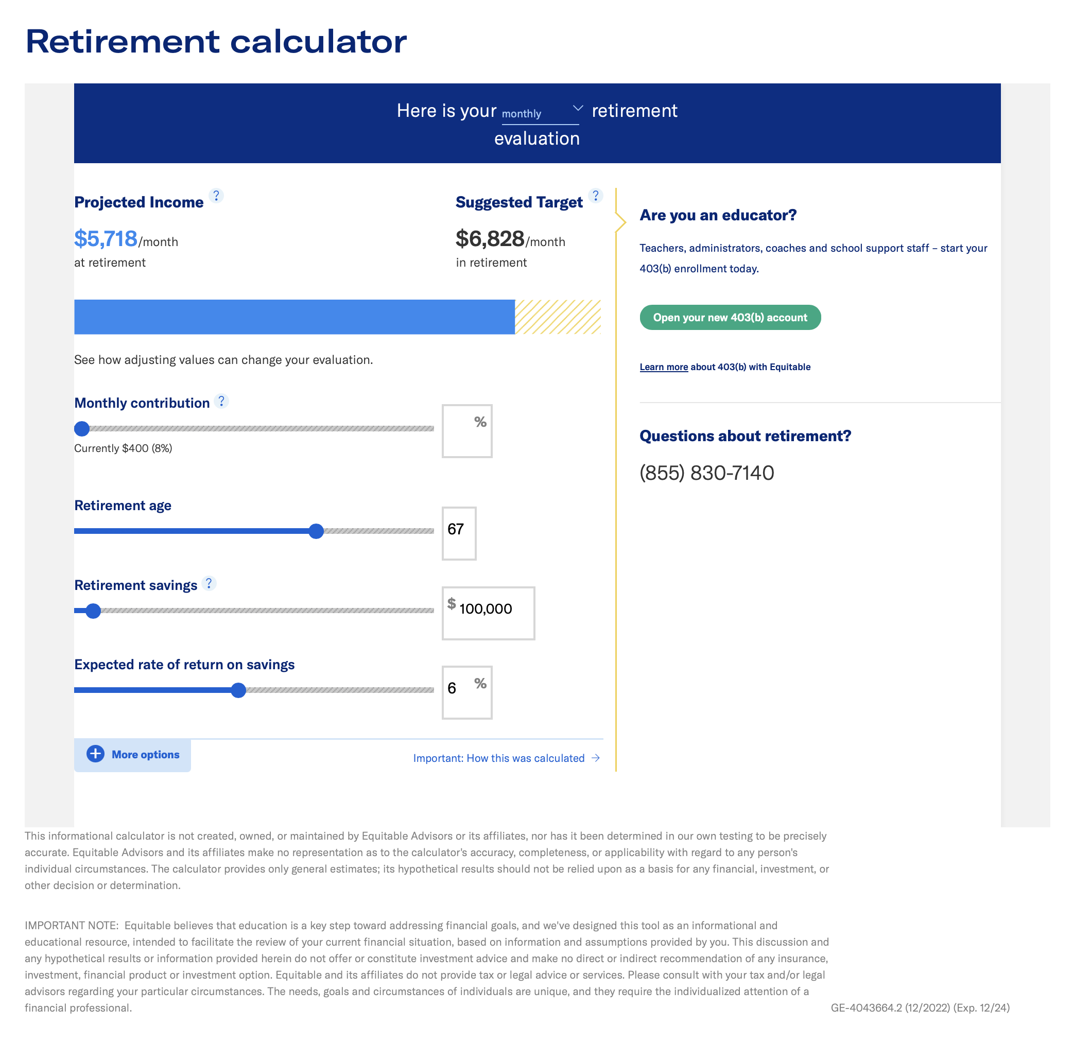

How much will you need
to retire?
Our retirement income calculator can help:
Determine your estimated retirement income goal, and how close you are to achieving it
Compare your retirement savings progress to others in the same age and income range
See how contributing more might help you close the gap and achieve your goal
18
Prepare for a comfortable retirement — 2025
18
Notes:
READ SLIDE
You can access our retirement income gap calculator at equitable.com/retirement.

Slide 19

Investing your money
Prepare for a comfortable retirement — 2025
19
Notes:
Now, let’s talk about investing your money, once it’s in your account.

Slide 20

Risk vs. reward
Each asset class has a risk/reward relationship
International Small/Mid Cap and Sector Specialty/Portfolios
Higher
risk
Higher
potential reward
Risk
Large Cap
High Yield
Investment Grade Bonds
Guaranteed Interest Option/Equitable Fixed Account/Cash Equivalents
Lower
risk
Lower
potential reward
More conservative
More aggressive
The principal value of target date funds are not guaranteed at any time, including at or after the target date.
Notes:
You’ll likely have lots of options for investing your money. Keep in mind that each asset class has a specific risk/reward relationship. As the risk gets higher, so does the potential for growth and return. As the risk gets lower, so does the potential return. It may be wise to have a balance of risk and reward in your overall portfolio – this will also help you diversify your investments. One way to do this is to add funds to your overall portfolio that are already diversified – such as asset allocation funds, which include a variety of asset classes, and target date funds, which start off with a more aggressive, growth-centered mix of assets, then slowly reallocate to a more conservative, income-centered mix of funds. Then, reallocate and adjust your portfolio, based on any changes to your retirement time horizon and risk.
With your plan, there are a few ways to diversify.

Slide 21

Diversify, based on your retirement date
Weighted %
Target date funds
How target date allocation portfolios work
(not an actual weighting; for illustration only)
Bonds
Stocks
Years to retirement
Years past retirement
The target date is the approximate date when investors plan to start withdrawing their money. The principal value of target date funds are not guaranteed at any time, including at or after the target date. Investors will incur higher costs with these portfolios than if they were to invest directly in the underlying investment portfolios.
Notes:
You can diversify based on your retirement date. By choosing a target date fund, you are automatically diversified, based on how far away you are from retirement. As you get closer to retirement, the fund manager will reallocate the investments within the fund so that it is more and more conservative.

Slide 22
Diversify, based on your risk tolerance
Example: Wilshire asset allocation models
Conservative allocation
Moderate allocation
U.S. Large cap 14%
U.S. Large cap 28%
U.S. Small cap 4%
U.S. Small cap 8%
International equity 7%
International equity 14%
Fixed income 70%
Fixed income 45%
Cash 5%
Cash 5%
Moderate aggressive allocation
Aggressive allocation
U.S. Large cap 38%
U.S. Large cap 49%
U.S. Small cap 11%
U.S. Small cap 14%
International equity 21%
International equity 27%
Fixed income 28%
Fixed income 10%
Cash 2%
Cash 0%
Asset allocation is a method of diversification that positions assets among major investment categories. This tool may be used in an effort to manage risk and enhance returns. However, it does not guarantee a profit or protect against a loss.
The Asset Allocation Investor Profile Questionnaire presented is available through an agreement between Wilshire Associates Incorporated (Wilshire®) and Equitable Financial Life Insurance Company (Equitable Financial).
This questionnaire is intended to help you determine your general attitudes toward investment risk, and the results should not be viewed as investment advice by Wilshire or Equitable Financial. The responses and the results of this questionnaire should be used only in the context of an expanded investment profile performed with your financial professional, which may factor in a broader range of questions. Other factors that impact your investment decisions may include personal income level and number of dependents, among other things.
Wilshire does not endorse and/or recommend any specific financial product or service that may be used in conjunction with the asset allocation models that are presented.
Wilshire is not affiliated with Equitable Financial and its family of companies.
Additionally, this questionnaire should not be viewed as investment advice or any solicitation on behalf of or by Equitable Distributors, LLC.
Notes:
Variable Slide
You can also diversify based on your risk tolerance, by choosing one or more of the asset allocation portfolios. The more aggressive they are, the more stocks they include. The more conservative they are, the more fixed income investments they include.

Slide 23
Investing your money
Asset allocation portfolios
These portfolios offer an easy, convenient way to attain an asset mix best suited to participant goals, time frame and attitude toward risk.
EQ/Aggressive Allocation
Highest potential reward/volatility
EQ/Moderate-Plus Allocation
EQ/Moderate Allocation
Target allocations
EQ/Conservative-Plus Allocation
Lowest potential reward/volatility
EQ/Conservative Allocation
Stocks
Large cap equities
Mid/Small cap equities
International equity
Fixed income
Target allocation percentages reflect approximate allocations as of May 2021 and are subject to change. Investors will incur higher costs with these portfolios than if they were to invest directly in the underlying portfolios. These portfolios are subject to market risk, including loss of principal.

Slide 24


Protection vs. choice
Building your own portfolio
More guarantees/protection
Less growth potential/less risk
More choice
More growth potential/more risk
Options for more certainty
Guaranteed Income Option (GIO)⁶
Participate in the market
Subaccounts, similar to mutual funds
6 The GIO value equals your contributions and any transfers into the option plus interest, less transfers or withdrawals out of the option, withdrawal charges and annual administrative charge. Check with your financial professional for any state variations that may apply. Withdrawals are subject to normal income tax treatment and, if taken prior to age 59½, may be subject to an additional 10% federal income tax. Withdrawals may be subject to a withdrawal charge of up to 3% in certain plans.
Notes:
You can also put together your own diversified portfolio, based on the various investments and options in your plan. The investments you elect will depend on what you’re looking for. If you want the most choice and the ability to participate in the market, you can choose from a variety of subaccounts. On the other side of the spectrum, if you’d prefer less choice but more protection and guarantees, you can choose the Guaranteed Interest Option and/or the [Personal Income Benefit].
Let’s talk about each of these separately.

Slide 25
Guaranteed growth
Guaranteed Interest Option
Account Value ($)
1
Contribute
Each contribution to the Guaranteed Interest Option increases your retirement account value.
2
Grow
Every year, interest will be earned and included in your account, compounding each year as interest earns more interest.
Years
Earned interest
Retirement savings
Notes:
Variable Slide
If guaranteed growth is more your style, you may want to consider the Equitable Fixed Account.
Equitable’s investment professionals understand and actively manage the diversified portfolio in our General Account in order to back our liabilities and deliver on the promises we made for years to come. A good example of this is our Fixed Account, which provides guaranteed interest and is backed by the investments we make in the General Account.

Slide 26




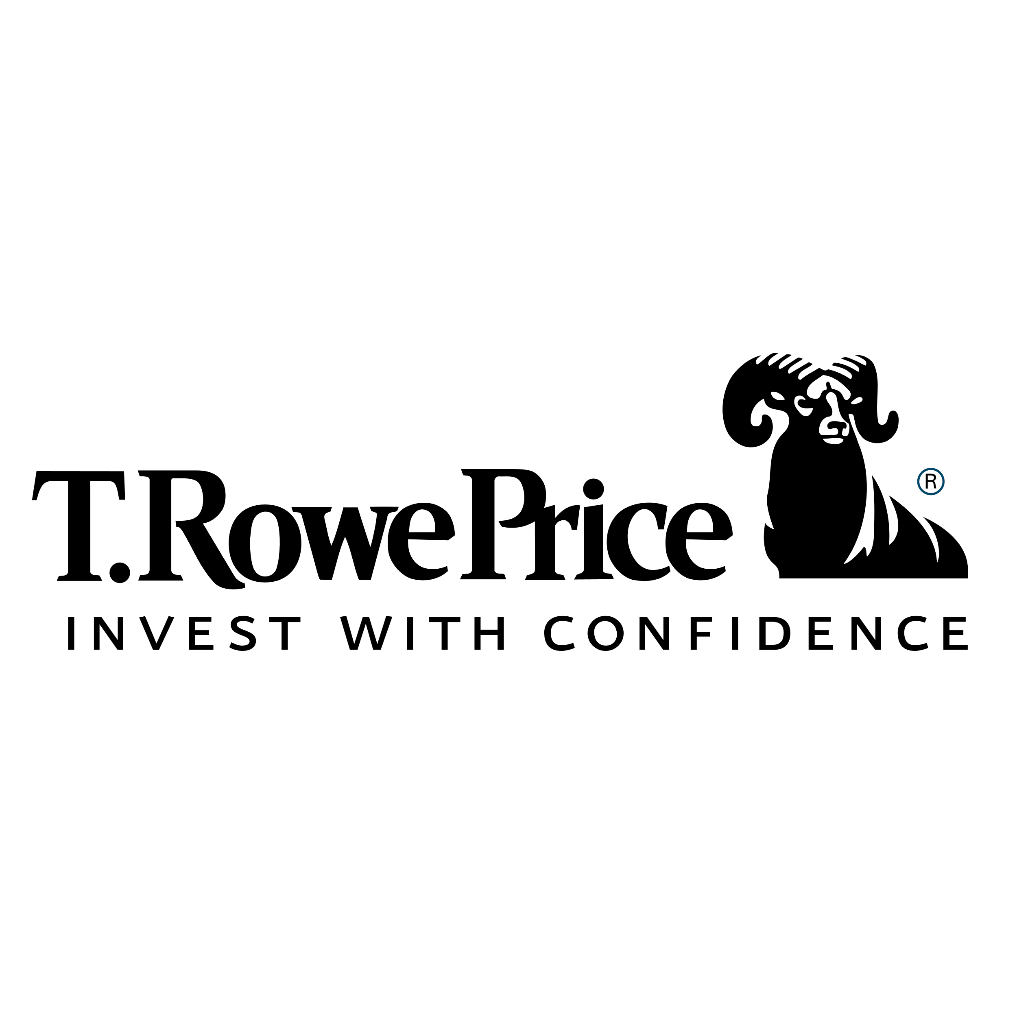











Participate in the market
Select from a wide variety of investment options, ranging from conservative to aggressive
AllianceBernstein is an affiliate of Equitable Financial Life Insurance Company and Equitable Financial Life Insurance Company of America.
Notes:
If you want to participate in the market, you’ll have plenty of choices. Here are just a few of the fund families represented in your investment option lineup.

Slide 27

Enrolling and managing your account
Prepare for a comfortable retirement — Month 00, 2024
27
Notes:
Now let’s talk about how to enroll and manage your retirement account.

Slide 28
Enroll in three simple steps
1
2
3
Figure out how much you want to save
Decide how to invest your money
Enroll using our online enrollment tool or with your Equitable Financial Professional
Notes:
Variable Slide
You can enroll in three simple steps:
Figure out how much you want to save
Decide how to invest your money
Then enroll, by filling out these forms

Slide 29


Enrollment made simple
You’re automatically enrolled.
But you can change the amounts and allocations.
Your contribution amount
Your allocation
Notes:
Variable Slide
We’ve made enrollment easy for you. In fact, you are automatically enrolled in your plan, though you have the flexibility to change your settings – how much you contribute, [other things??] – if you want.

Slide 30






Help managing your account
Automated phone line:
(800) 757-7777
457(b)
Equitable
Team
Customer service representative: (800) 628-6673
Monday–Thursday: 8:30 a.m. to 7 p.m. ET
Friday: 8:30 a.m. to 5 p.m. ET
Notes:
Variable Slide
You also have personal guidance if you need it. You can call our automated phone line to make changes or find out information about your account. Our customer service representatives are available as well and happy to help you in any way they can. Your financial professional is also there to help if you need it.

Slide 31




Your account is portable
Take it with you wherever you go
If you take your account, remember:
Your contributions are always 100% vested
Withdrawals and distributions allowed when conditions are met
There is NO employer match
Taxes apply upon withdrawal⁸
8 Taxes may apply to Roth contributions if distributed before age 59½ or have not been invested for longer than 5 years.
Notes:
Variable Slide
And, if you decide to leave your job, you can take your money with you. Your contributions are always 100 percent vested, though a vesting schedule may apply to your employer contributions. You may be able to take withdrawals or distributions if certain conditions are met, and taxes will apply under certain circumstances.

Slide 32

Working with Equitable
Prepare for a comfortable retirement — Month 00, 2024
32
Notes:
We also want you to know that Equitable is there for you.

Slide 33
Meet Our Team
Let us show you how saving a little more now can help you plan for a comfortable retirement tomorrow
Anthony J. Stevens III
Vice President
(315) 425-6307
anthony.stevens@equitable.com
Gabrielle L. DiMora
Financial Advisor
(315) 425-6347
gabrielle.dimora@equitable.com
Michael Fasulo
Financial Advisor
(315)425-6383
michael.fasulo@equitable.com
Andrew J. Haberern
Financial Advisor
(315)425-6355
andrew.haberern@equitable.com
Deven Coleman
Financial Advisor
(315) 425-6363
deven.coleman@equitable.com
Notes:
Variable Slide
You also have personal guidance if you need it. You can call our automated phone line to make changes or find out information about your account. Our customer service representatives are available as well and happy to help you in any way they can. Your financial professional is also there to help if you need it.

Slide 34
Why you should consider working with a financial professional to build a fulfilling future:
According to a recent study, those who work with a financial professional are better off than those who don’t.
A financial professional can help you face the future with courage, strength and wisdom.
With a financial professional
Without a financial professional
$48k
$39k
Median account balance
$9k
$5.3k
Mean annual contribution
75%
46%
Satisfaction with account performance
84%
59%
Satisfaction with 403(b) plan
Source: Equitable 2022 Advisor Value Study.
Prepare for a comfortable retirement — 2025
34
Notes:
Here are a few benefits of working with an advisor and continuing our relationship.
READ SLIDE

Slide 35
Depend on the experience of Equitable
At Equitable, we use our experience to earn your trust. Our financial stability. Our innovative products and services. Our abiding commitment to know you and guide you. We meet you where you are with advice and strategies tailored to you, continuing a tradition of service we’ve honored since 1859. Along the way, we’ve gained respect as one of America’s leading financial services companies. And we’ve earned the trust of our clients and their families for generations.¹⁰
160
2.6m
years and counting
clients
More than
$212b
4,258
assets under management
dedicated financial professionals in communities all over the United States¹¹
10 These facts refer to specifically and exclusively to Equitable Financial Life Insurance Company (NY, NY) and Equitable Financial Life Insurance Company and Equitable Financial Life Insurance Company of America, December 31, 2022.
11 All financial professionals are associates of affiliates Equitable Advisors, LLC (member FINRA, SIPC) (Equitable Financial Advisors in MI & TN) and Equitable Network, LLC (Equitable Network Insurance Agency of California, LLC; Equitable Network Insurance Agency of Utah, LLC; Equitable Network of Puerto Rico, Inc.).
Notes:
Read Slide

Slide 36
Thank you.

