Slide 1
Onondaga County employees open enrollment The summit federal credit union Your credit union benefit
Presented by The Summit Federal Credit Union

Slide 2
Who we are
The Summit Federal Credit Union is a member-owned, not-for-profit financial institution serving the Finger Lakes region and Western and Central NY for over 80 years
Our financial solutions include a full range of banking products and services to help you save and borrow at competitive rates and terms
We’re an important part of your company’s employee benefit package and you and your entire family are eligible to join!

Slide 3
full-service banking Solutions
Smart Saving
Traditional Checking
Happy Borrowing
Mortgages
Visa Credit Cards w/ rewards
Convenient Services
Virtual Branch Banking
Direct Deposit
Home Buyers Dream Program
Auto Loans
Mobile & Online Banking
Quik Tran
Payroll Deduction
Visa Debit Cards w/rewards
Youth Accounts
Online Bill Payment
Digital Wallets
Money Markets and Share Certificates (CDs)
Home Equity Products
Financial Education & Credit Counseling
Personal Loans
Student Loans
Savings & Club Accounts
Health Savings Accounts
Digital Spend Accounts
Retirement & Investment Services
RoundUp Savings Account

Slide 4
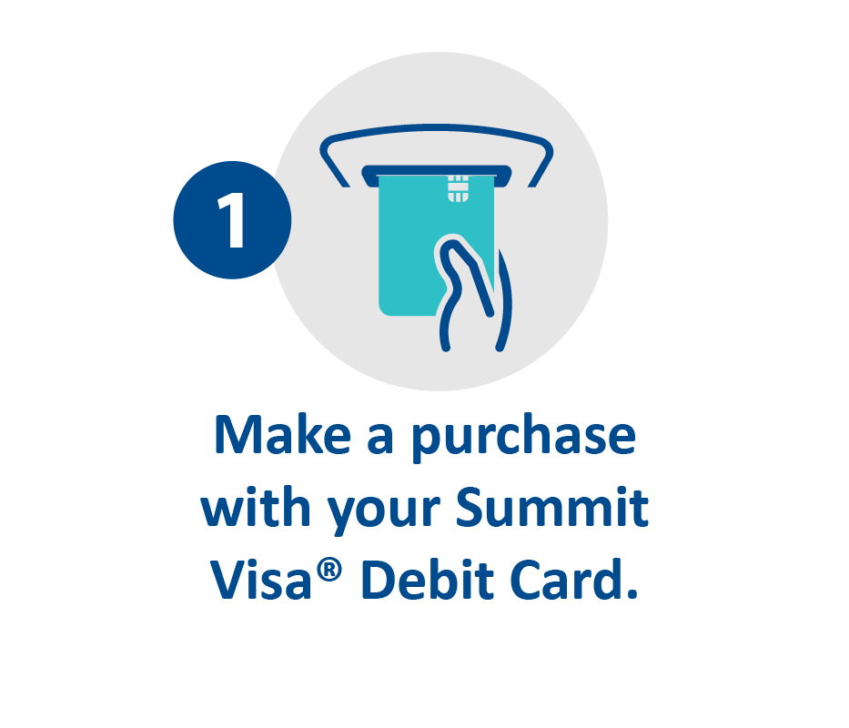
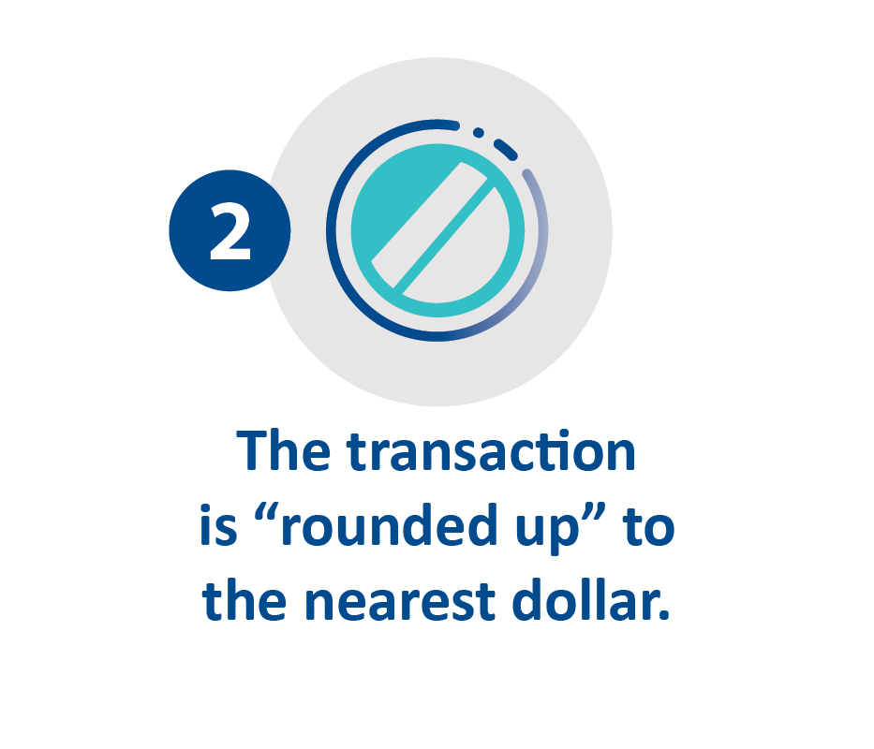
Savings solutions
Our New RoundUp Savings Account was specifically designed to help you reach your savings goals. How does it work?
As a new member or an existing member, enrollment is easy.

Slide 5
Student loan options
Invest in your future with a student loan from The Summit.
We are proud to offer great low rates on undergraduate and graduate student loans, and student loan refinancing.
Visit www.summitfcu.org/loans/student-loans/
to learn more.

Slide 6
1st time homebuyer solutions
The Summit participates in the seasonal* Homebuyer Dream Program through the FHLBNY
This is a seasonal grant program, giving the applicant up to $10,000.00** towards down payment and closing costs for their first home purchase
The Summit waives the PMI (Private Mortgage Insurance) for our members when financing through this program
*Program available annually in the spring/summer
**Grant amount subject to change**

Slide 7
Our newest branch is open
The Summit’s Virtual Branch brings the personal
face-to-face service you love right to you, wherever you are!
See and talk with a Summit Relationship Specialist over Zoom. You can do almost everything you’d do at a physical branch — right from your mobile or electronic device.
It’s easy, convenient and safe.
www.summitfcu.org/virtualbranch
Zoom appointments are available
9am – 6pm Monday thru Friday
Saturday hours coming soon!

Slide 8
Have questions or Ready to open an account?
Visit a Summit Branch | Schedule your Zoom appointment | Learn more about our solutions
Find a branch near you at summitfcu.org | summitfcu.org/virtual branch | Visit summitfcu.org
Contact your Summit Business Relations Account Executive today! Kate Thompson | kcthompson@summitfcu.org |Serving Syracuse, Cortland & Seneca Falls or
Tina Longwell | longwell@summitfcu.org | Serving Rochester & Buffalo

